Slide 1

Application Layer Protocols
and
Services -2
Delivered By:
Avinash Bhagat
9463281930
avinash.bhagat@lpu.co.in
Copyright © The McGraw-Hill Companies, Inc. Permission required for reproduction or display.

Slide 2
Domain Name System (DNS) Chapter 25
TELNET Chapter 26
Simple Mail Transfer Protocol and Post Office Protocol Chapter 26
File Transfer Protocol Chapter 26
World Wide Web www Chapter27
Hyper text transfer Protocol HTTP Chapter27
Terminologies in Network Security Chapter30
Firewalls Chapter32
Virtual Private Network (VPN) Chapter32

Slide 3
Between1970 to about 1990, the Internet and its predecessors had four main applications:
Remote Logging,
Electronic Mail,
File Transfer
News
Copyright © The McGraw-Hill Companies, Inc. Permission required for reproduction or display.

Slide 4
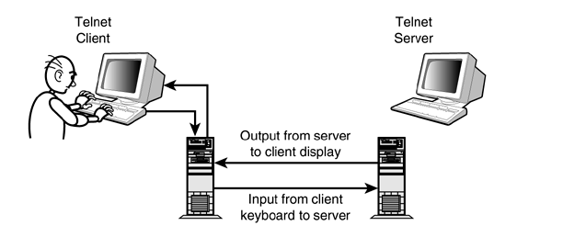
TELNET:
TELNET is an abbreviation for TErminaL NETwork.

Slide 5
TELNET:
TELNET is an abbreviation for TErminaL NETwork.
TELNET enables the establishment of a connection to a remote system in such a way that the local terminal appears to be a terminal at the remote system.
  Characteristics of TELNET
  Timesharing Environment
  Logging
      Local Logging
      Remote Logging
  Network Virtual Terminal
  Embedding
  Options

Slide 6
Time Sharing Environment
    TELNET was designed at a time when most operating systems, such as UNIX, were operating in a timesharing environment. In such an environment, a large computer supports multiple users.

Slide 7
Logging
    In a timesharing environment, users are part of the system with some right to access resources.
    To access the system, the user logs into the system with a user id or log-in name.
    Local Logging
    Remote Logging

Slide 8
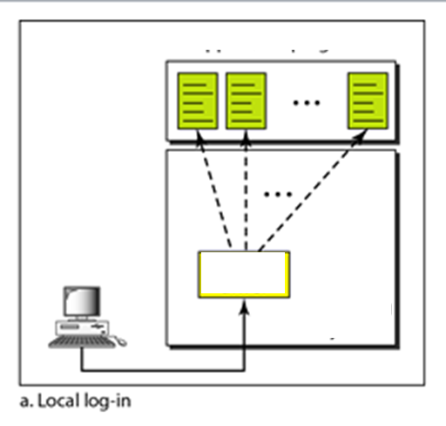

Slide 9
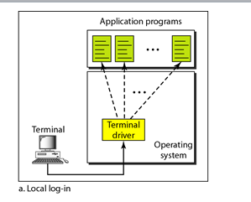
When a user logs into a local timesharing system, it is called local log-in. As a user types at a terminal or at a workstation running a terminal emulator, the keystrokes are accepted by the terminal driver. The terminal driver passes the characters to the operating system. The operating system, in turn, interprets the combination of characters and invokes the desired application program or utility.

Slide 10
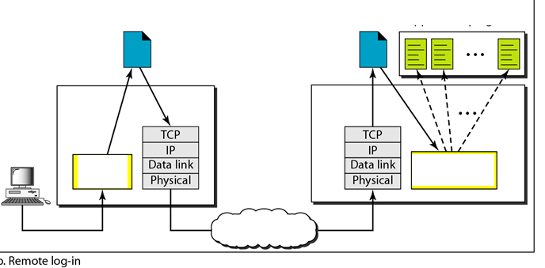

Slide 11
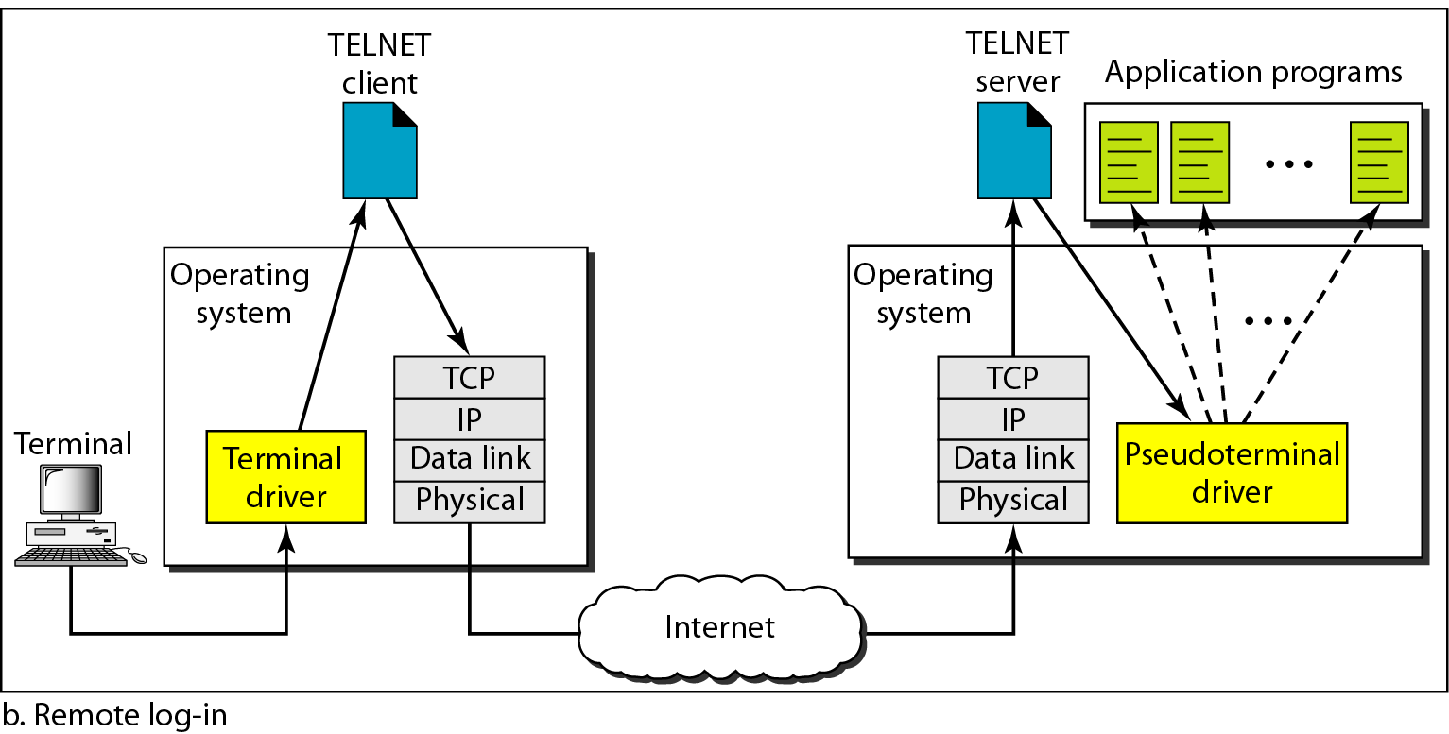
When a user wants to access an application program or utility located on a remote machine.
Here the TELNET client and server programs
come into use.
The user sends the keystrokes to the terminal driver, where the local operating system accepts the characters but does not interpret them.

Slide 12
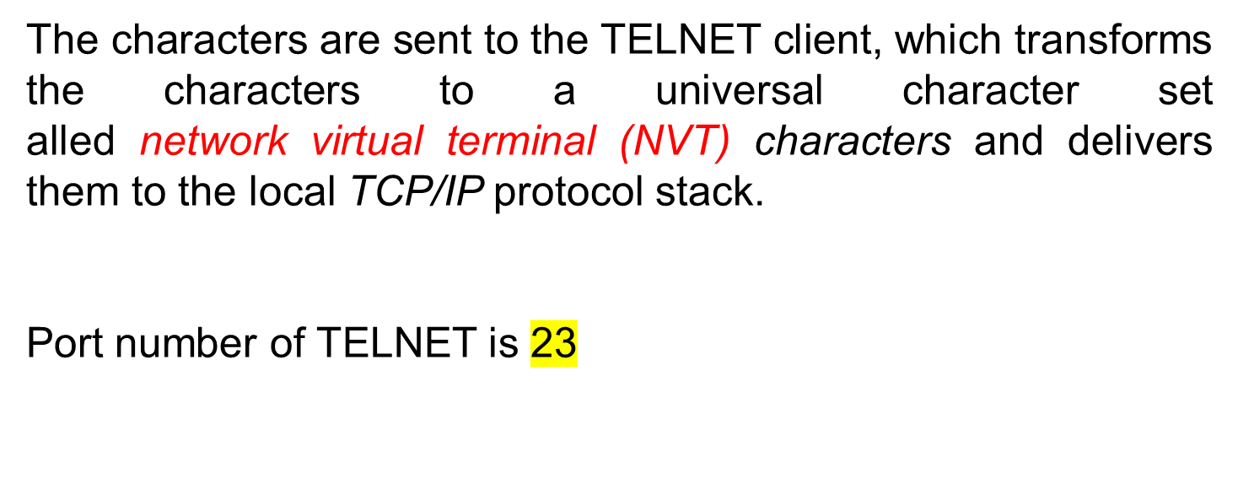

Slide 13
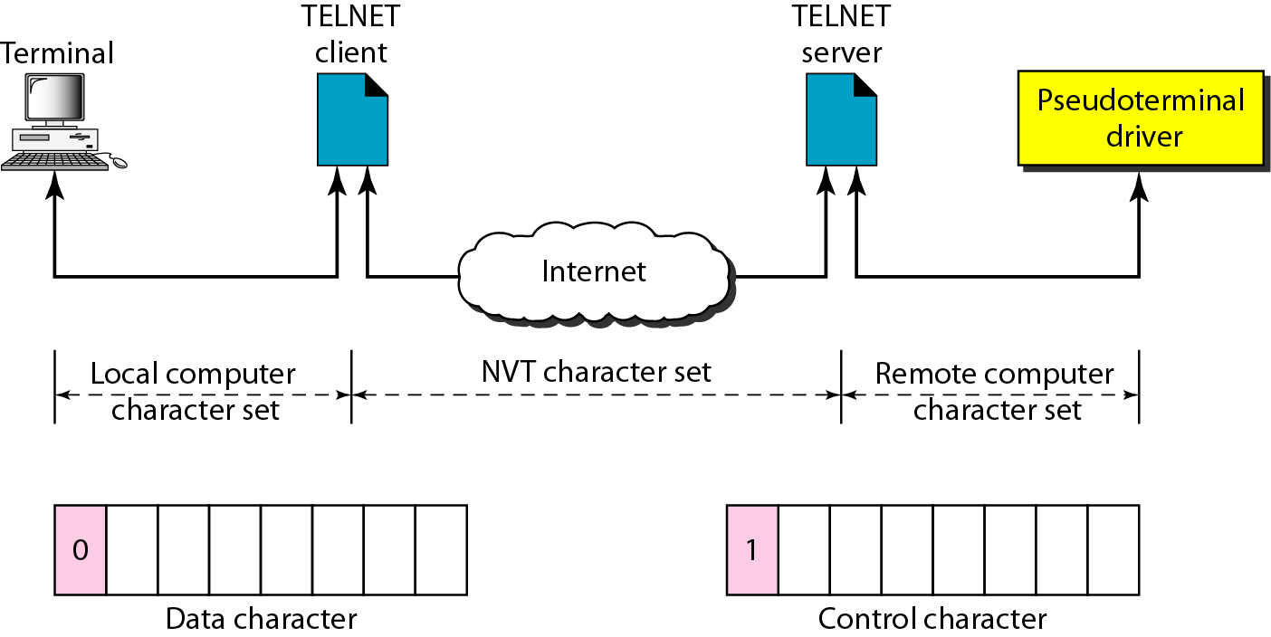
Network Virtual Terminal (NVT)
We are dealing with heterogeneous systems.
If we want to access any remote computer in the world, we must first know what type of computer we will be connected to, and we must also install the specific terminal emulator used by that computer.
TELNET solves this problem by defining a universal interface called the network virtual terminal (NVT) character set. Via this interface, the client TELNET translates characters (data or commands) that come from the local terminal into NVT form and delivers them to the network.
The server TELNET, on the other hand, translates data and commands from NVT form into the form acceptable by the remote computer.

Slide 14
Subjective Questions
Write a note on TELNET

Slide 15
Multiple Choice Questions
TELNET is an abbreviation for ____________.
a. terminal network
b. telephone network
c. telecommunication network
d. none of the above

Slide 16
Multiple Choice Questions
TELNET is an abbreviation for ____________.
a. terminal network
b. telephone network
c. telecommunication network
d. none of the above

Slide 17
Multiple Choice Questions
The _______ is software residing on the remote system that allows the remote system to receive characters from a TELNET server.
a. terminal driver
b. pseudoterminal driver
c. TELNET client
d. none of the above

Slide 18
Multiple Choice Questions
The _______ is software residing on the remote system that allows the remote system to receive characters from a TELNET server.
a. terminal driver
b. pseudoterminal driver
c. TELNET client
d. none of the above

Slide 19
Multiple Choice Questions
The _______ translates local characters into NVT form.
a. terminal driver
b. TELNET client
c. TELNET server
d. none of the above

Slide 20
Multiple Choice Questions
The _______ translates local characters into NVT form.
a. terminal driver
b. TELNET client
c. TELNET server
d. none of the above

Slide 21
Multiple Choice Questions
The _______ translates NVT characters into a form acceptable by the remote operating system.
a. terminal driver
b. TELNET client
c. TELNET server
d. none of the above

Slide 22
Multiple Choice Questions
The _______ translates NVT characters into a form acceptable by the remote operating system.
a. terminal driver
b. TELNET client
c. TELNET server
d. none of the above

